Slide 1

CSE 591 Time Series Visualization and Analysis
Ross Maciejewski
rmacieje@asu.edu

Slide 2
Time-Oriented Data
Time is an outstanding dimension reflected by Shneiderman’s Task by Data Type Taxonomy¹
Time oriented data is ubiquitous, stock markets, movie trends, business, medicine
Each data case is likely an event of some kind, with one variable being the date and time
W. Aigner, S. Miksch, W. Muller, H. Schumann, C. Tominski, "Visual Methods for Analyzing Time-Oriented Data", IEEE Trans. On Visualization and Computer Graphics, Vol. 14, No. 1, Jan.-Feb. 2008, pp. 47-60.

Slide 3
Time Series
A random selection of 4000 graphs from 15 newspapers and magazines worldwide showed that between 1974 and 1980, 75% of these graphs were time series¹
What questions can we ask of these visuals?²
Does a data object exist at a certain time?
When does a certain data object exist?
How long does a data object exist?
How fast and how much does the data object change?
What order to objects appear/disappear?
Is there a cyclical pattern to appearances?
Which objects exist simultaneously?
1 – E. Tufte, “The Visual Display of Quantitative Information,” 1983.
2 – A. MacEachren, “How Maps Work,: Representation, Visualization and Design,” The Guilford Press, 1995.

Slide 4
Time
Time is ordered
We assume one time point precedes another
The notion of time being ordered is closely bound to the notion of causality (things that happen close together in time are often related)
Time is continuous
We often break time into discrete components for analysis
Most people think of time as a flowing stream
Time is cyclical
Time is independent of location
L. Wilkinson, The Grammar of Graphics, Springer, 2005

Slide 5
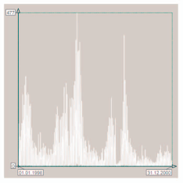
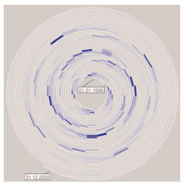
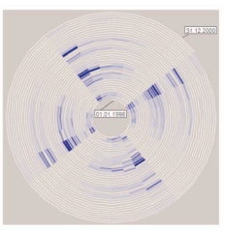
Linear vs. Cyclical Time
Linear time assumes a starting point and defines the time domain with data elements from the past and future
Natural processes may be cyclic (e.g., seasons)
The ordering of points in a cyclic time domain would be meaningless
Winter comes before summer, but also after summer
W. Aigner, S. Miksch, W. Muller, H. Schumann, C. Tominski, "Visual Methods for Analyzing Time-Oriented Data", IEEE Trans. On Visualization and Computer Graphics, Vol. 14, No. 1, Jan.-Feb. 2008, pp. 47-60.

Slide 6
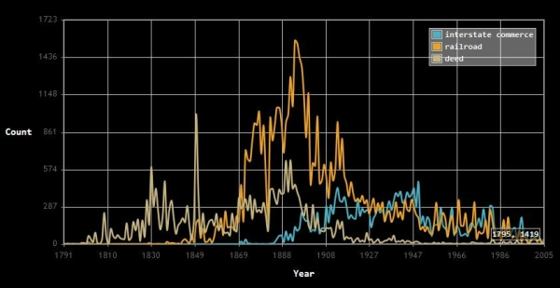
Linear Time
Standard presentation
2D line graph with time on x-axis and value on y-axis
New Database Creates Time-Series Plots of Phrases in U.S. Supreme Court Opinions December 16, 2011 | Posted by: Scott C. Idleman: http://law.marquette.edu/facultyblog/2011/12/16/new-database-creates-time-series-plots-of-phrases-in-u-s-supreme-court-opinions/

Slide 7

Sparkline
“Intense, simple, wordlike graphics”
http://sparkline.org/

Slide 8
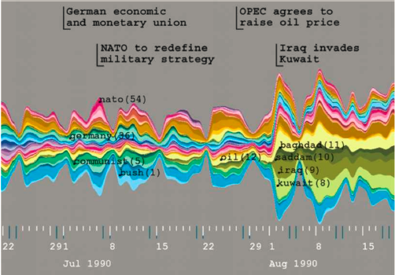
Theme River
1– S. Havre, E. Hetzler, P. Whitney, and L. Nowell. Themeriver: Visualizing thematic changes in large document collections. IEEE Transactions on Visualization and Computer Graphics 8(1):9-20, 2002.
* - Theme River Image from: http://www.nytimes.com/interactive/2008/02/23/movies/20080223_REVENUE_GRAPHIC.html#

Slide 9
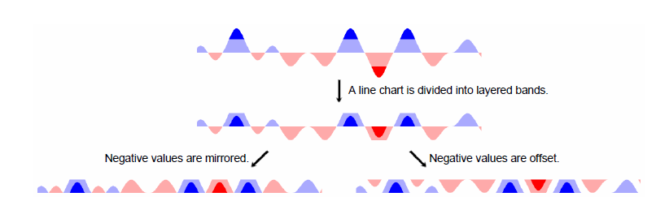
Sizing the Horizon
Jeffrey Heer, Nicholas Kong, and Maneesh Agrawala. 2009. Sizing the horizon: the effects of chart size and layering on the graphical perception of time series visualizations. In Proceedings of the 27th international conference on Human factors in computing systems (CHI '09). ACM, New York, NY, USA, 1303-1312.

Slide 10
Linear Vs. Cyclical
Trends are easily seen in a linear plot, but what about repeating patterns?
One idea is to use spirals as they easily represent the idea of repetition
Finding periodicity may be easier than a bar chart because similar distances in a bar chart may look periodic when in fact they are not

Slide 11
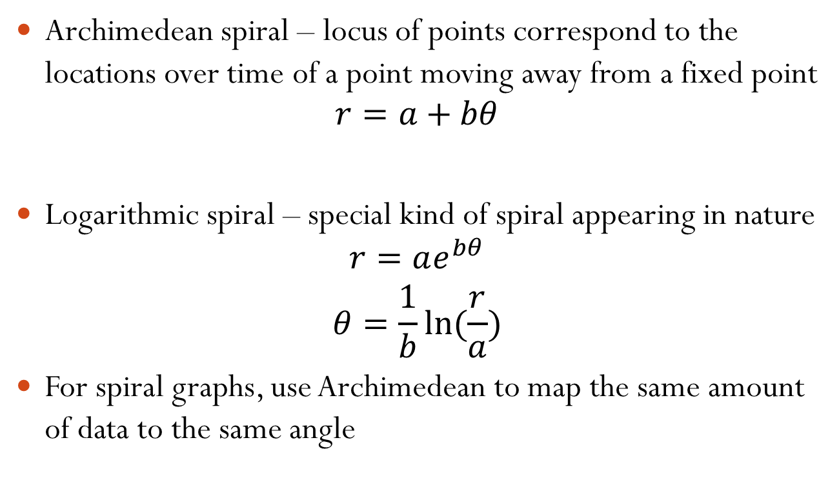
Spiral Graph
Archimedean spiral – locus of points correspond to the locations over time of a point moving away from a fixed point
$$r=a+bθ$$
Logarithmic spiral – special kind of spiral appearing in nature
$$r=ae^{bθ}$$
$$θ=\frac{1}{b}ln⁡(\frac{r}{a})$$
For spiral graphs, use Archimedean to map the same amount of data to the same angle

Slide 12
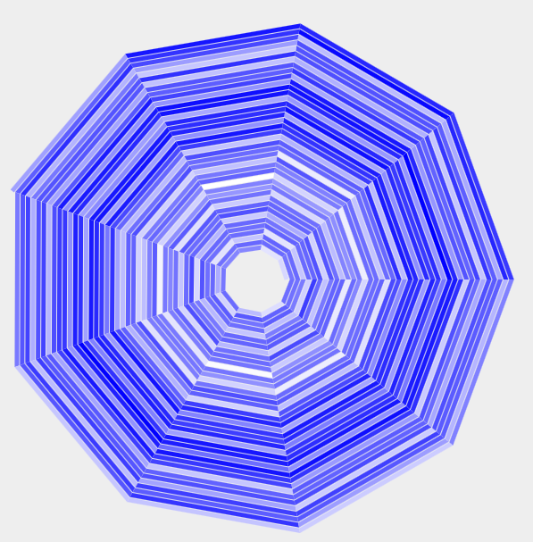
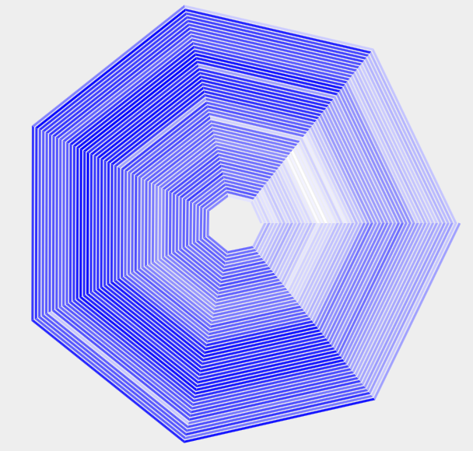
Spiral Graph
9 Day Spiral
7 Day Spiral
Number of people born each day in 1978
1 - John V. Carlis and Joseph A. Konstan, Interactive Visualization of Serial Periodic Data, Proceedings User Interface Software and Technology (UIST), pp. 29-38, 1998
2 - M. Weber, M. Alexa, and W. Mu¨ ller, “Visualizing Time-Series on Spirals,” Proceedings of the IEEE Symposium on Information Visualization (InfoVis ’01), pp. 7-14, Oct. 2001.
3 - Spirals for Periodic Data By Robert Kosara On August 7, 2011: http://eagereyes.org/techniques/spirals

Slide 13
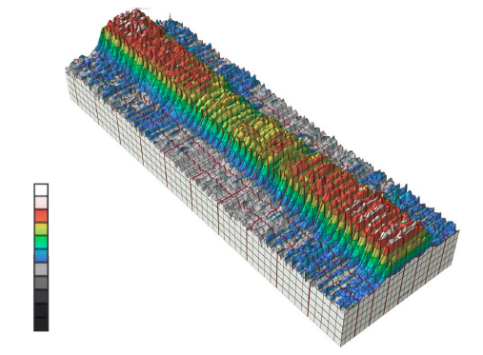
Calendar Based Visualization
1 – J. J. Van Wijk and E. R. Van Selow. Cluster and calendar based visualization of time series data. Proceedings of the 1999 IEEE Symposium on Information Visualization, 1999.

Slide 14
Calendar Based Visualization
Su M T W Th F Sa Su M T W Th F Sa
1/1
3
2
2
0
2
0
0
2
2
3
0
1
1
5
9
5
3
1
2
2
2
1
4
1
0
1
0
5
1/15
1
0
3
1
1
2
0
1
0
1
0
0
0
0
1/29
4
1
0
1
2
3
3
2
1
2
1
3
2
6
2/12
3
5
6
2
1
3
2
1
7
1
3
2
1
2
2/26
0
0
0
0
0
0
1
0
0
4
2
0
0
0
3/11
9
9
0
1
1
2
3
6
4
1
1
3
2
2
3/25
5
3
1
2
0
0
3
1
2
4
3
2
3
3
4/8
0 2 4 6 8 10
1 – J. J. Van Wijk and E. R. Van Selow. Cluster and calendar based visualization of time series data. Proceedings of the 1999 IEEE Symposium on Information Visualization, 1999.

Slide 15
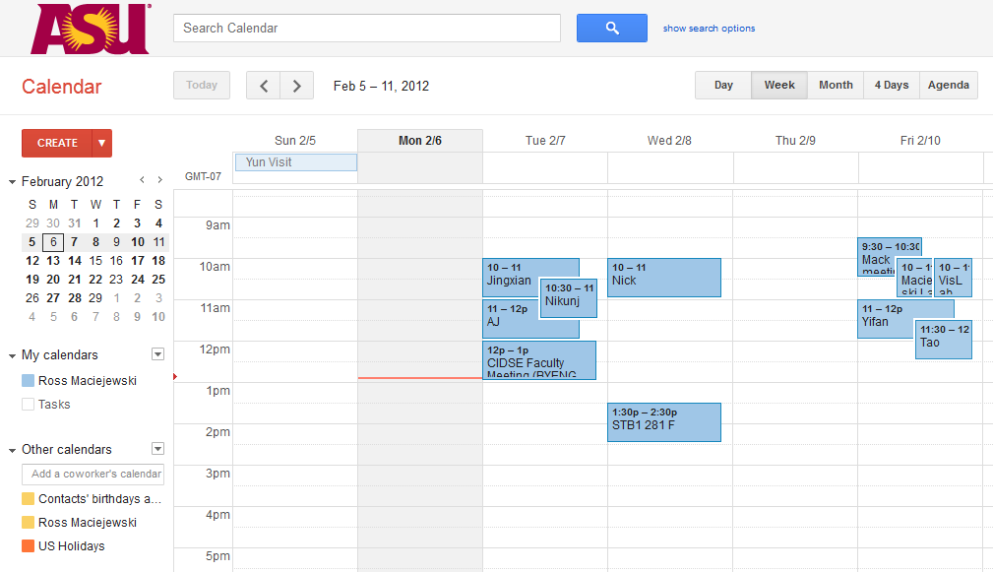
Calendar Visualization

Slide 16
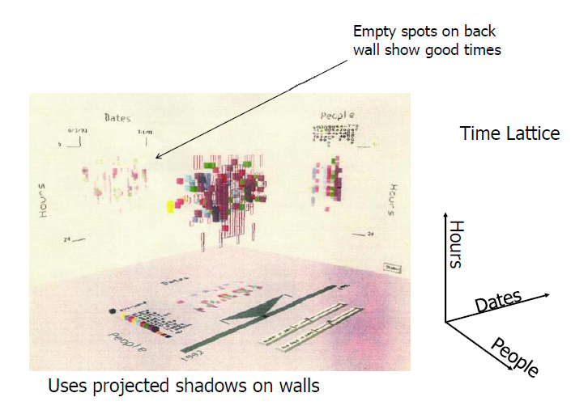
Spiral Calendar
Mackinlay, J., Robertson, G. G., and DeLine, R., “Developing Calendar Visualizers for the Information Visualizer,” UIST 1994.

Slide 17
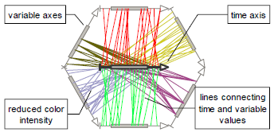
Time Wheel
C. Tominski, J. Abello, and H. Schumann, “Axes-Based Visualizations with Radial Layouts,” Proceedings of the ACM Symposium on Applied Computing, pp. 1242-1

Slide 18
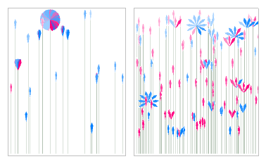
People Gardens
Rebecca Xiong and Judith Donath. 1999. PeopleGarden: creating data portraits for users. In Proceedings of the 12th annual ACM symposium on User interface software and technology (UIST '99). ACM, New York, NY, USA, 37-44.

Slide 19
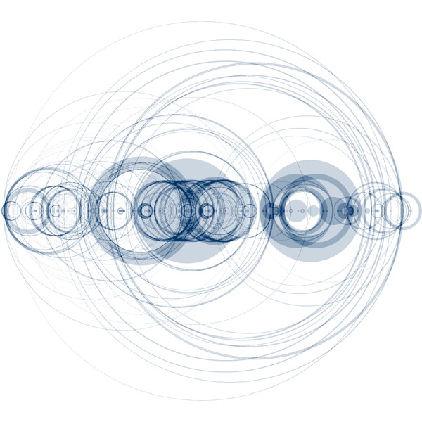
Arc Diagrams
1– M. Wattenberg, “Arc Diagrams: Visualizing Structure in Strings,” InfoVis 2002.
http://www.bewitched.com/song.html

Slide 20
Ordered Time vs. Branching Time
Ordered time domains consider things that happen one after another
Branching time considers multiple what-if scenarios, allowing comparison of alternate scenarios
Can support decision making process where only one alternative is chosen
W. Aigner, S. Miksch, W. Muller, H. Schumann, C. Tominski, "Visual Methods for Analyzing Time-Oriented Data", IEEE Trans. On Visualization and Computer Graphics, Vol. 14, No. 1, Jan.-Feb. 2008, pp. 47-60.

Slide 21
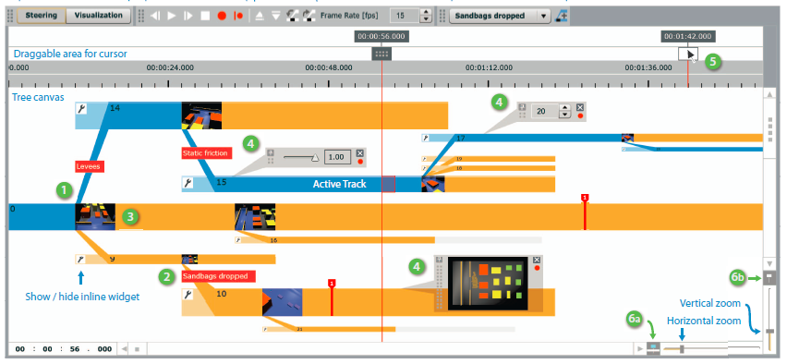
World Lines
Creating new simulation tracks through temporal branching
Waser, J.; Fuchs, R.; Ribičič, H.; Schindler, B.; Blöschl, G.; Gröller, E.; , "World Lines," IEEE Transactions on Visualization and Computer Graphics, vol.16, no.6, pp.1458-1467, Nov.-Dec. 2010

Slide 22
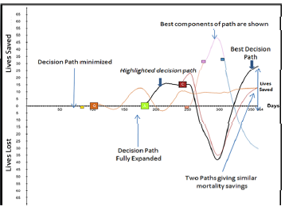
Shehzad Afzal, Ross Maciejewski, and David S. Ebert. Visual Analytics Decision Support Environment for Epidemic Modeling and Response Evaluation. IEEE Conference on Visual Analytics Science and Technology (VAST), 2011.

Slide 23
Design Principles
Show familiar visual representations whenever possible
Provide side-by-side comparisons of small multiple views
Spatial position is strongest visual cue
Multiple views are more effective when coordinated through explicit linking
Avoid abrupt visual change
Borrowed from John Stasko’s Time Series Data lecture: http://www.cc.gatech.edu/~stasko/7450/Notes/time.pdf

Slide 24
Data Mining
Data mining domain has techniques for examining time series, looking for patterns, looking for anomalies
Can be used to enhance the visualizations, show us what is important
Can also be used in exploratory analysis, “I think this looks interesting, show me similar trends.”

Slide 25
Typical Time Series Analysis
Identifying Patterns
Trend analysis
A company’s linear growth in sales over the years
Seasonality
Sales are higher in summer than winter
Forecasting
What is the expected sales of next quarter

Slide 26
Temporal Analysis Methods
For temporal data, we can find anomalies using control chart methods
Control charts consist of a statistic representing some measurement in time (number of patients in a hospital, value of a stock, etc.)
The mean and standard deviation of the statistic is calculated given all the available samples
If the current value is greater than some pre-set number of standard deviations from the mean, then an alert is generated (Shewart suggested three standard deviations)

Slide 27
Control Chart Methods
What is a control chart?
The control chart is a graph used to study how a process changes over time. Data are plotted in time order.
A control chart always has a central line for the average, an upper line for the upper control limit and a lower line for the lower control limit.
Lines are determined from historical data. By comparing current data to these lines, you can draw conclusions about whether the process variation is consistent (in control) or is unpredictable (out of control, affected by special causes of variation).

Slide 28
Control Chart Methods
When to use a control chart?
Controlling ongoing processes by finding and correcting problems as they occur.
Predicting the expected range of outcomes from a process.
Determining whether a process is stable (in statistical control).
Analyzing patterns of process variation from special causes (non-routine events) or common causes (built into the process).
Determining whether the quality improvement project should aim to prevent specific problems or to make fundamental changes to the process.

Slide 29
Control Chart Model
General model for a control chart
Upper Control Limit = μ + kσ
Center Line = μ
Lower Control Limit = μ – kσ
where μ is the mean of the variable, and σ is the standard deviation
of the variable.
When k is set to 3, we speak of 3-sigma control charts. Historically, k = 3 has
become an accepted standard in industry.

Slide 30
Moving Average/Range Charts
Moving Average / Range Charts are a set of control charts for variables data.
The Moving Average chart monitors the process location over time, based on the average of the current subgroup and one or more prior subgroups. The Range chart monitors the process variation over time.
Moving Average Charts are generally used for detecting small shifts in the process mean. They will detect shifts of .5 sigma to 2 sigma much faster. They are, however, slower in detecting large shifts in the process mean.
Always look at the Range chart first. The control limits on the Moving Average chart are derived from the average range, so if the Range chart is out of control, then the control limits on the Moving Average chart are meaningless.

Slide 31
Moving Average
A simple moving average is formed by computing the average price of a measure over a specific number of periods.
In this example we’ll look at stock market closing prices
A 5-day simple moving average is the five day sum of closing prices divided by five.
As its name implies, a moving average is an average that moves. Old data is dropped as new data comes available.
This causes the average to move along the time scale. Below is an example of a 5-day moving average evolving over three days.
Daily Closing Prices: 11,12,13,14,15,16,17
First day of 5-day SMA: (11 + 12 + 13 + 14 + 15) / 5 = 13 Second day of 5-day SMA: (12 + 13 + 14 + 15 + 16) / 5 = 14 Third day of 5-day SMA: (13 + 14 + 15 + 16 + 17) / 5 = 15

Slide 32
Exponentially Weighted Moving Average
Exponential moving averages reduce the lag by applying more weight to recent prices.
The weighting applied to the most recent price depends on the number of periods in the moving average.
There are three steps to calculating an exponential moving average.
First, calculate the simple moving average.
An exponential moving average (EMA) has to start somewhere so a simple moving average is used as the previous period's EMA in the first calculation.
Second, calculate the weighting multiplier.
Third, calculate the exponential moving average. The formula below is for a 10-day EMA.
SMA: 10 period sum / 10
Multiplier: (2 / (Time periods + 1) ) = (2 / (10 + 1) ) = 0.1818 (18.18%)
EMA: {Close - EMA(previous day)} x multiplier + EMA(previous day).

Slide 33
The Lag Factor
The longer the moving average, the more the lag.
A 10-day exponential moving average will hug prices quite closely and turn shortly after prices turn.
Short moving averages - nimble and quick to change.
Longer moving - slow to change.
Even though there are clear differences between simple moving averages and exponential moving averages, one is not necessarily better than the other.
Exponential moving averages have less lag and are therefore more sensitive to recent prices - and recent price changes.
Simple moving averages, on the other hand, represent a true average of prices for the entire time period. As such, simple moving averages may be better suited to identify support or resistance levels.
The length of your moving average depends on your analytical goal

Slide 34
Finding Similarities in Time Series
Indexing problem
Find all stocks whose fluctuations are similar to stock X
Subsequence Similarity
Find out other days in which stock x had similar movements as today
Clustering
Group regions that have similar temporal patterns
Rule Discovery
Find rules like if x goes up, y goes up, etc.

Slide 35
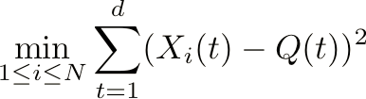
Finding Similarities
Brute force search:
Given query time series Q, the best match by sequential scanning is found by:
Method is O(nd)

Slide 36
Indexing Approach
Extract a few key features for each time series (think PCA and MDS)
Map each time sequence X to a point f(X) in the lower dimensional space
This allows for faster indexing for finding similarities
Research problem is to design solutions that are both accurate and efficient

Slide 37
Euclidean Similarity Measure
View each time series as a point in n-dimensional space
Calculate the “distance” between each point
Easy to compute
Scalable solution to other problems
Does not allow for different baselines

Slide 38
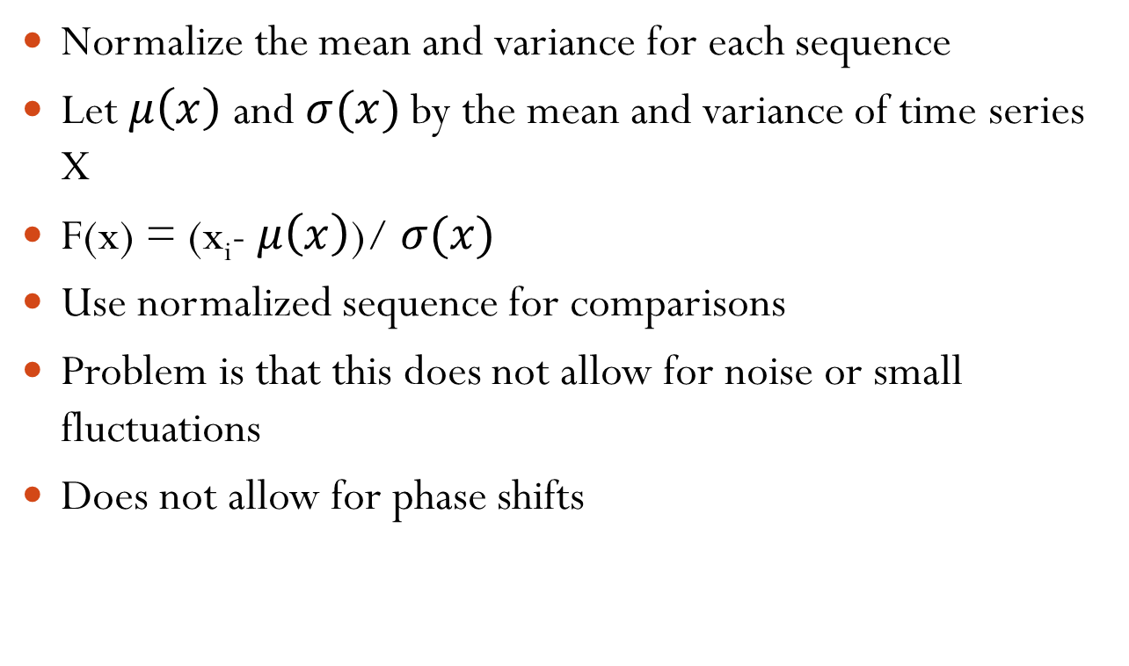
Normalization of Sequences
Normalize the mean and variance for each sequence
Let $μ\left(x\right)$ and $σ(x)$ by the mean and variance of time series X
F(x) = (x_{i}- $μ\left(x\right)$)/ $σ(x)$
Use normalized sequence for comparisons
Problem is that this does not allow for noise or small fluctuations
Does not allow for phase shifts

Slide 39
Readings and Homework
Required Reading:
W. Aigner, S. Miksch, W. Muller, H. Schumann, C. Tominski, "Visual Methods for Analyzing Time-Oriented Data", IEEE Trans. on Visualization and Computer Graphics, Vol. 14, No. 1, Jan.-Feb. 2008, pp. 47-60.
L. Byron & M. Wattenberg, "Stacked Graphs - Geometry & Aesthetics", IEEE Trans. on Visualization and Computer Graphics, Vol. 14, No. 6, Nov.-Dec. 2008, pp. 1245-1252.
Kincaid, R.; , "SignalLens: Focus+Context Applied to Electronic Time Series," IEEE Transactions on Visualization and Computer Graphics, vol.16, no.6, pp.900-907, Nov.-Dec. 2010
Homework
Homework #3 is due in one week!

Slide 40
Questions?

